Slide 1
RecSys Model Extraction Attack
Group: Garfunkle
Alexander Schoolcraft, Scott Fitz Gerald, Josh Murphy, Simon Kuester

Slide 2
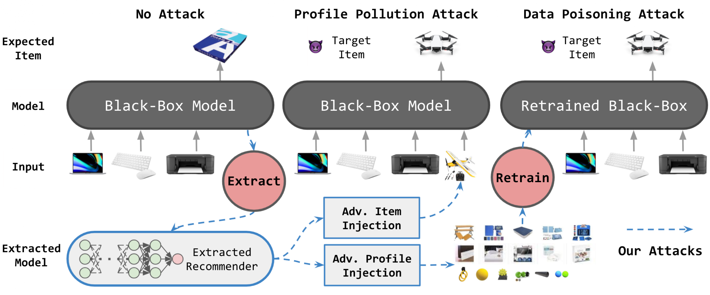
The Process
Notes:
Generate the initial models using a given dataset.
Use a dataset to extract the black-box model’s weights, to create an identical white-box model through distillation.
Use the white-box model to generate adversarial images to pollute the profile.
Poison the dataset to corrupt the model, causing the model to give higher preference to the targeted items

Slide 3
The Models and Dataset
BERT4Rec
A highly complex recommender model that runs on transformers with attention layers.
SASRec
A less complex recommender model, still runs on transformers, however it does not contain the attention layers.
NARM
A Recurrent Neural Network (RNN) that includes attention layers. The least complex of the three models.
Games
http://snap.stanford.edu/data/amazon/productGraph/categoryFiles/ratings_Video_Games.csv
CSV with 4 columns: UUID, SID, Rating, and UNIX Timestamp
Notes:
The first step in this process was to build the initial black box models. These all performed well, with strong values for a recommender system’s metrics: Recall@k and Normalized Discounted Cumulative Gain@k (where ‘k’ is a value of 1, 5, or 10) - this indicates how much a targeted value appears as expected in the top 1/5/10 lists.

Slide 4
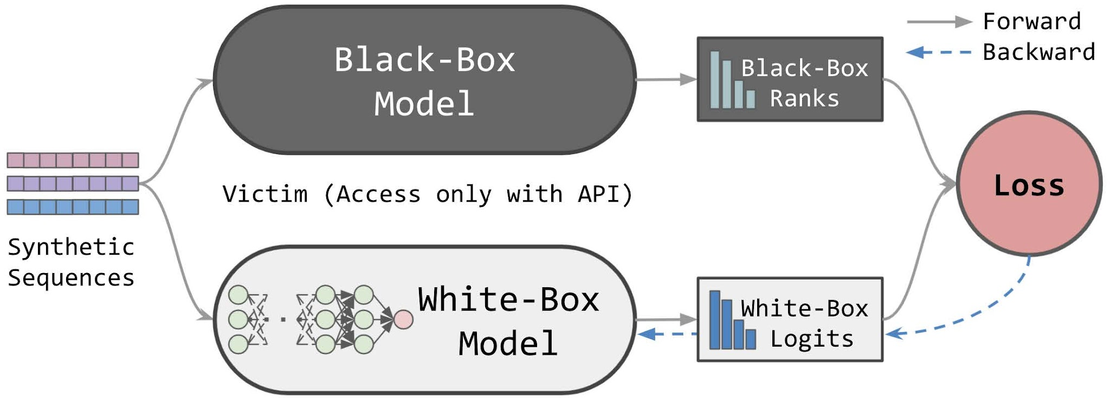
Extracting the Model
Notes:
Once the black box models were built - the next step is to extract the weights of the models using a distillation process to create a white box model that can be used for crafting adversarial data.

Slide 5
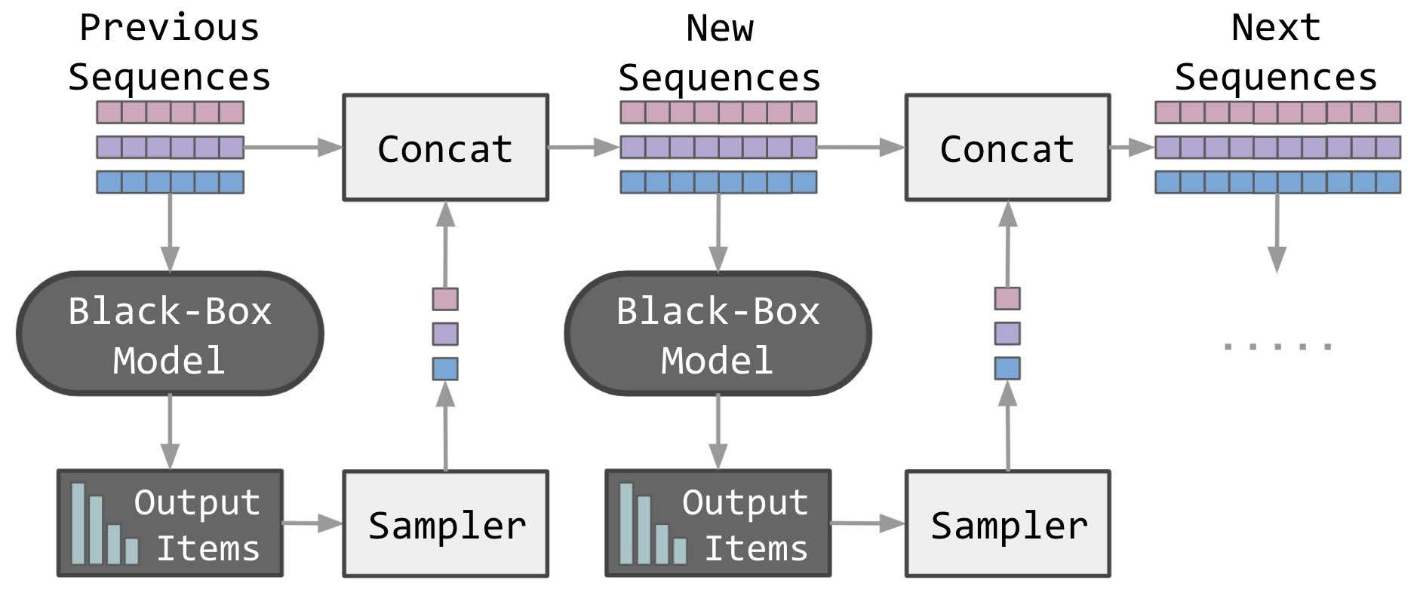
Autoregression

Slide 6
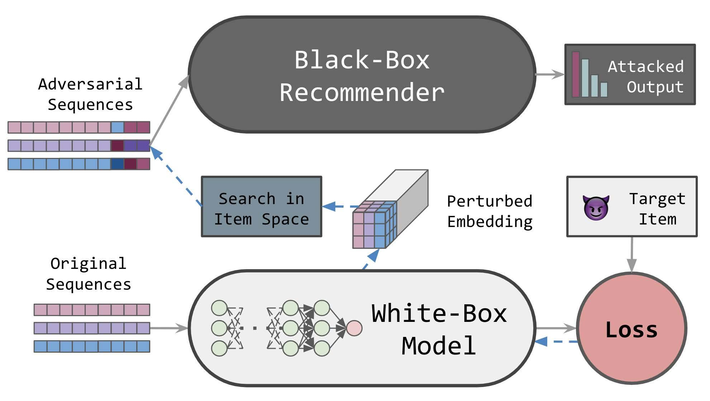
Build the pollution data

Slide 7
Algorithm 1: Adversarial Item Search for Profile Pollution
Input sequence 𝒙, target 𝑡 , expected length of polluted sequence 𝑇 , white-box model 𝒇𝑤 (i.e. 𝒇𝑤,𝑒 , 𝒇𝑤,𝑚), 𝜖 and 𝑛;
Output polluted sequence 𝒛;
initialize 𝒛 with 𝒛 = 𝒙;
while length of 𝒛 < 𝑇 do
extend 𝒛 by appending target item: 𝒛 ← [𝒛; 𝑡 ];
transform sequence into sequence embeddings: ˜𝒛 = 𝒇𝑤,𝑒 (𝒛);
compute backward gradients using cross entropy ∇ = ∇˜𝒛Lce (𝒇𝑤,𝑚(˜𝒛), 𝑡 );
compute cosine similarity scores 𝑺 between ˜𝒛 − 𝜖sign(∇) and 𝒇𝑤,𝑒 (𝑖) ∀𝑖 ∈ I;
select 𝑛 candidates 𝑪 with highest 𝑺 scores, exclude 𝑡 if repeated;
replace 𝑡 in 𝒛 with 𝑐 ∈ 𝑪 and keep 𝒛 with highest 𝒇𝑤(𝒛) [𝑡 ] ;
end

Slide 8
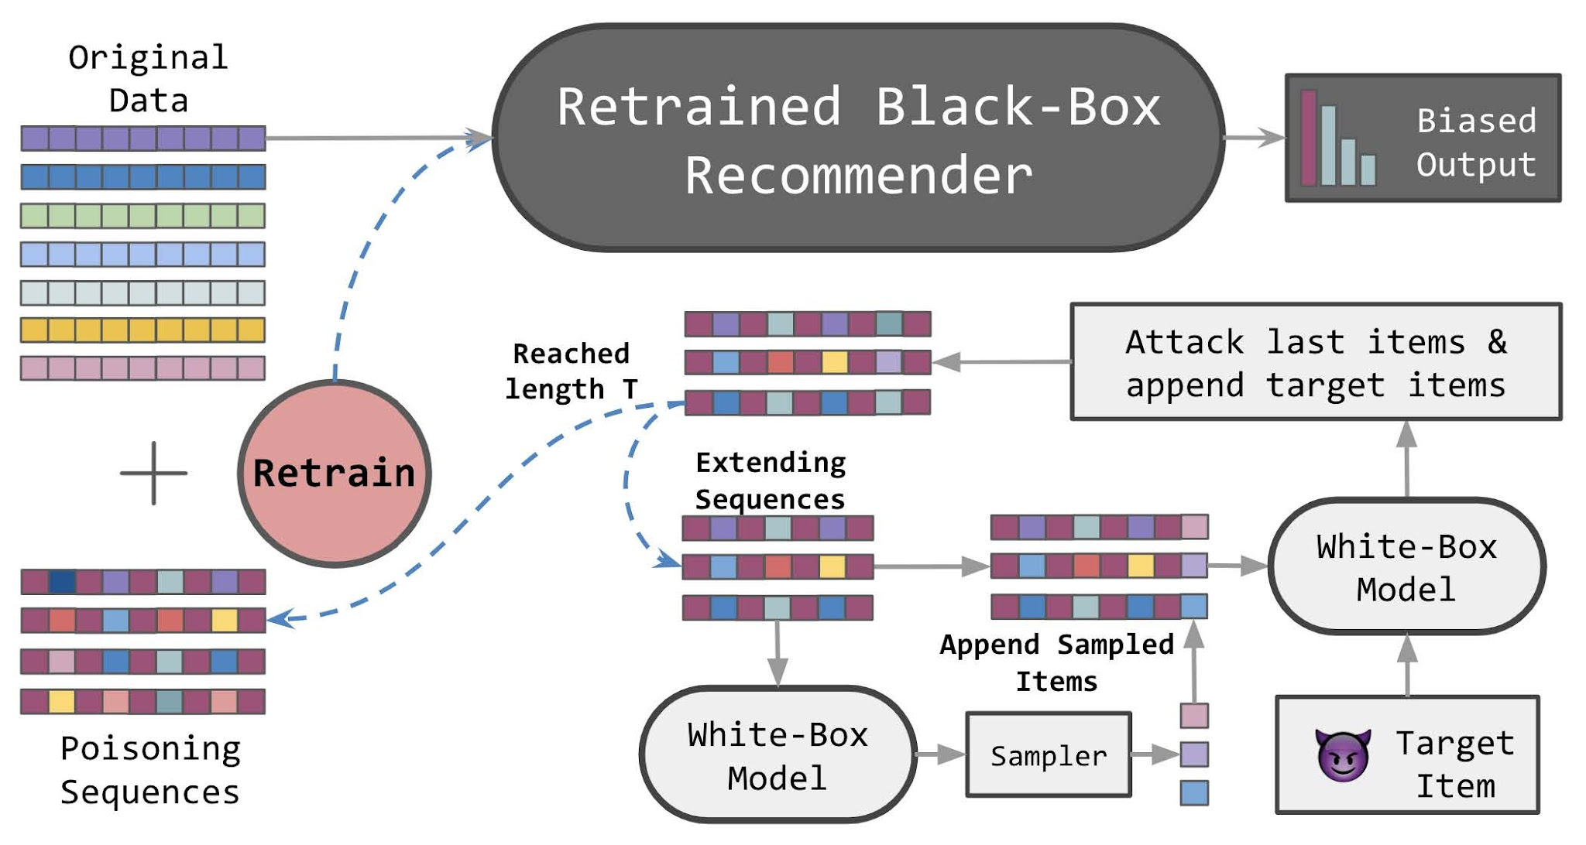
Conduct the pollution attack

Slide 9
Algorithm 2: Adversarial Profile Generation for Data Poisoning
Input target 𝑡 , expected length 𝑇 , white-box model 𝒇𝑤 (i.e. 𝒇𝑤,𝑒 , 𝒇𝑤,𝑚), 𝜖 and 𝑛;
Output adversarial profile 𝒛;
initialize 𝒛 with 𝒛 = [𝑡 ];
while length of 𝒛 < 𝑇 do
sample item 𝑧temp in I and append to 𝒛: 𝒛 = [𝒛; 𝑧temp];
transform sequence into sequence embeddings: ˜𝒛 = 𝒇𝑤,𝑒 (𝒛);
compute backward gradients using cross entropy ∇ = ∇˜𝒛Lce (𝒇𝑤,𝑚(˜𝒛), 𝑡 );
compute cosine similarity scores 𝑺 between ˜𝒛 − 𝜖sign(∇) and 𝒇𝑤,𝑒 (𝑖) ∀𝑖 ∈ I;
select 𝑛 candidates 𝑪 with lowest 𝑺 scores, exclude 𝑡 if repeated;
sample item in 𝑪 and replace 𝑧temp in 𝒛;
append target item 𝒛 ← [𝒛; 𝑡 ];
end

Slide 10
Issues
There were several issues with the code that caused numerous errors. The most common was related to PyTorch updates, namely that they removed the ‘zero_gradients’ method. So, had to remove all of the imports, which almost every single file imported, then a few of them actually employed the method, so had to modify the code some to not use it but still retain the proper functionality. Additionally, the code was supposed to take in arguments from the command line, however, these did not work properly, and this caused issues with the number of epochs in the code - it was originally hard-coded at 1000 by default. Finally, the ‘games’ dataset did not have full implementation for the final step, so we had to modify the code a little on the last step to implement the dataset.

Slide 11
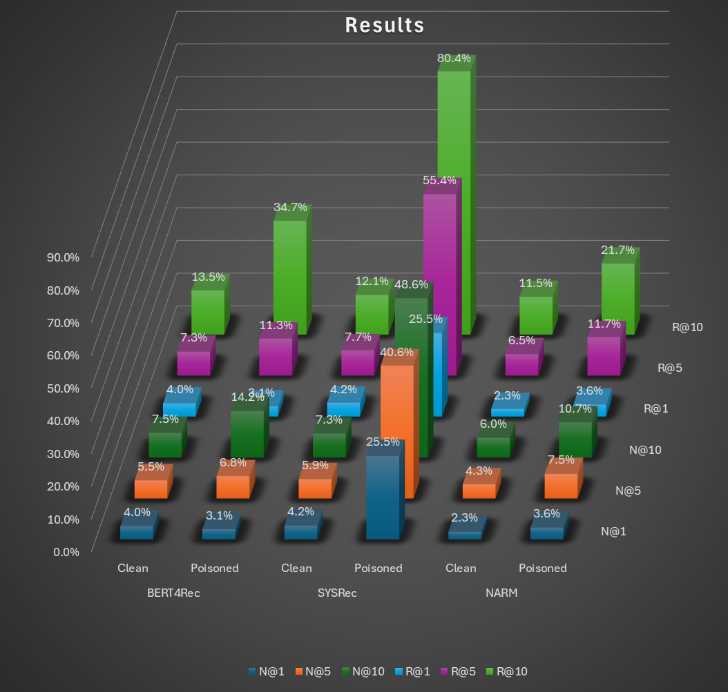
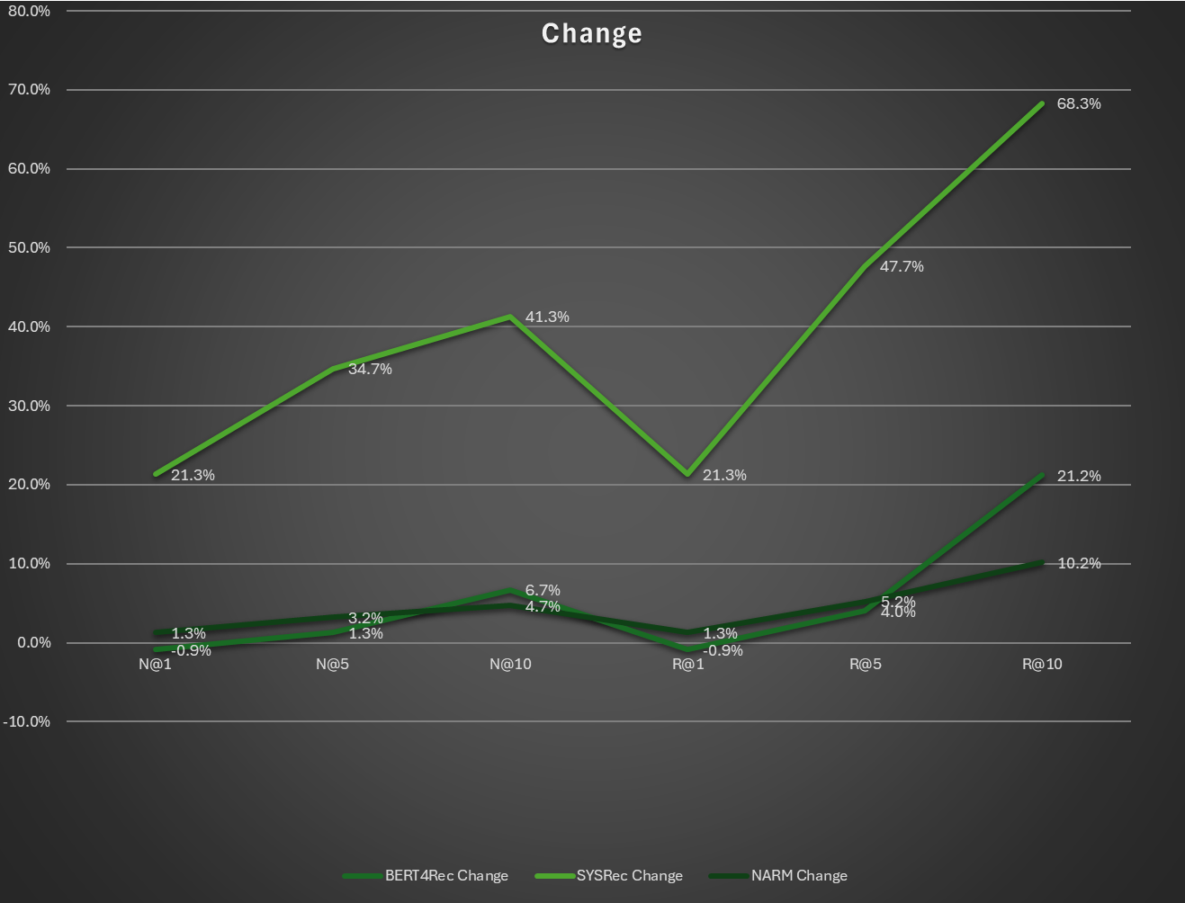
Our Results
Notes:
This is a pollution attack - so, the higher the change value, the more successful the attack was.

